Slide 1
315 Million
iOS Devices

Slide 2


Slide 3
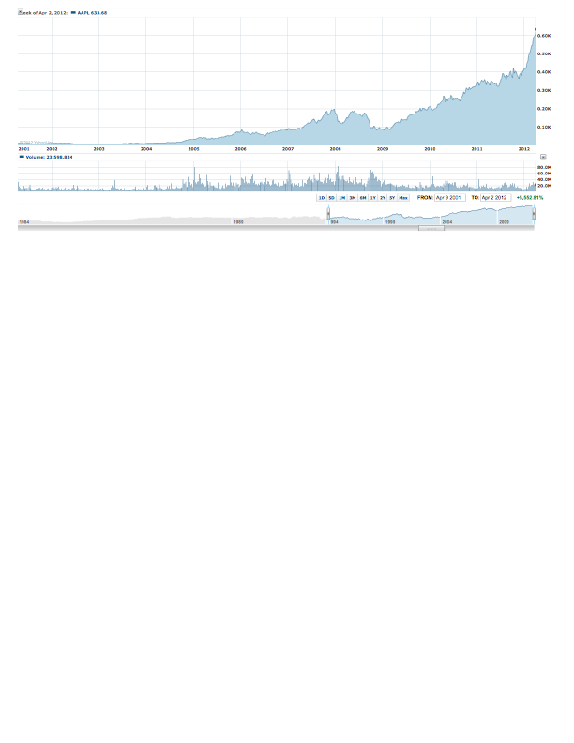

Slide 5





Slide 6
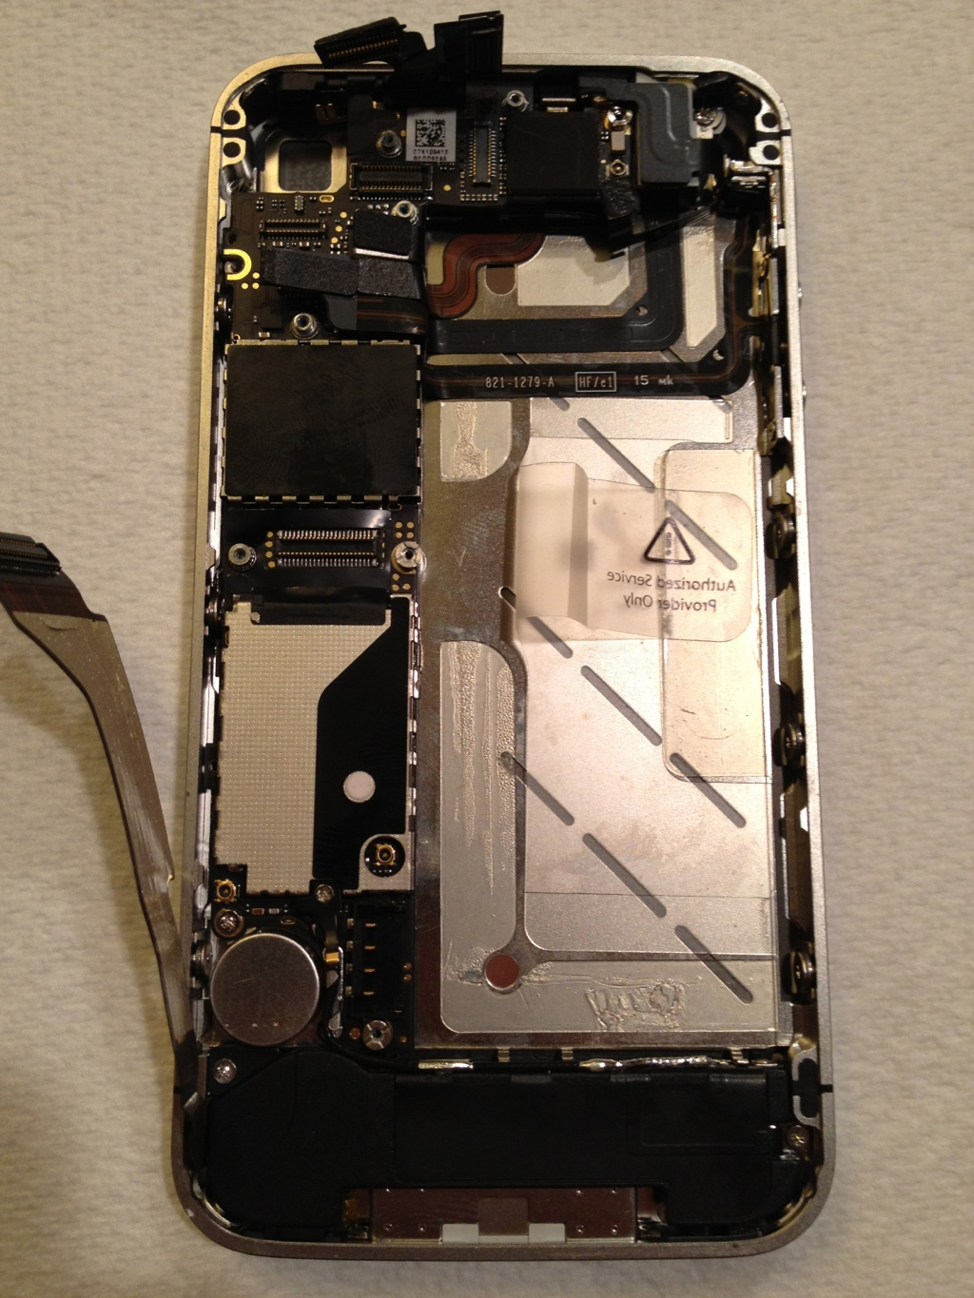
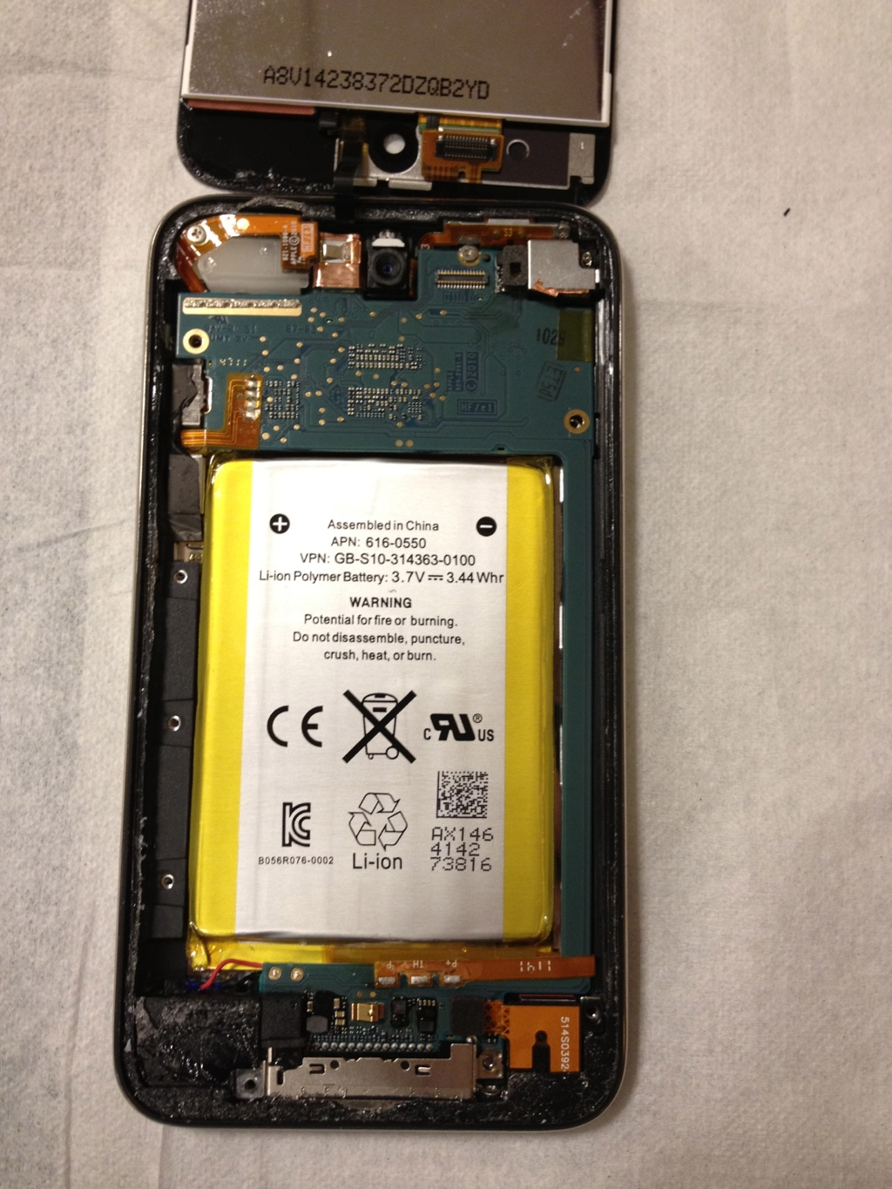

Slide 7



Slide 8
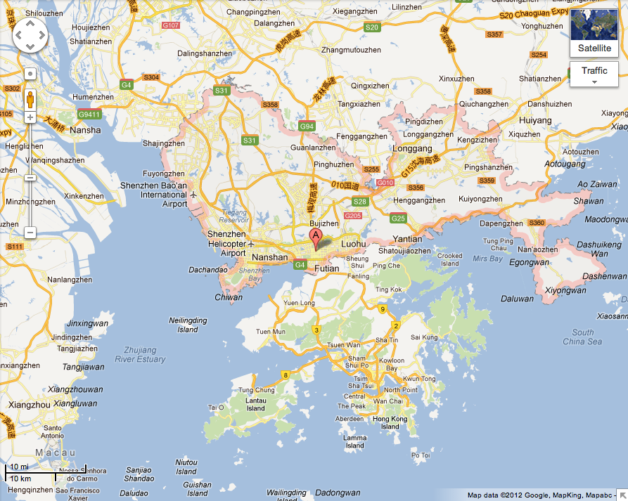


Slide 9
